Slide 1
Logistic Regression
CSE 329

Slide 2
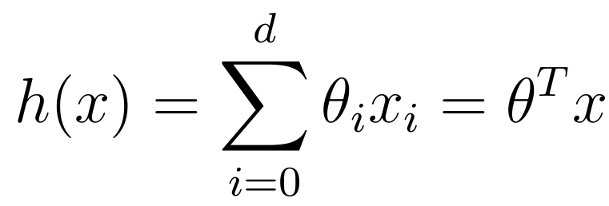
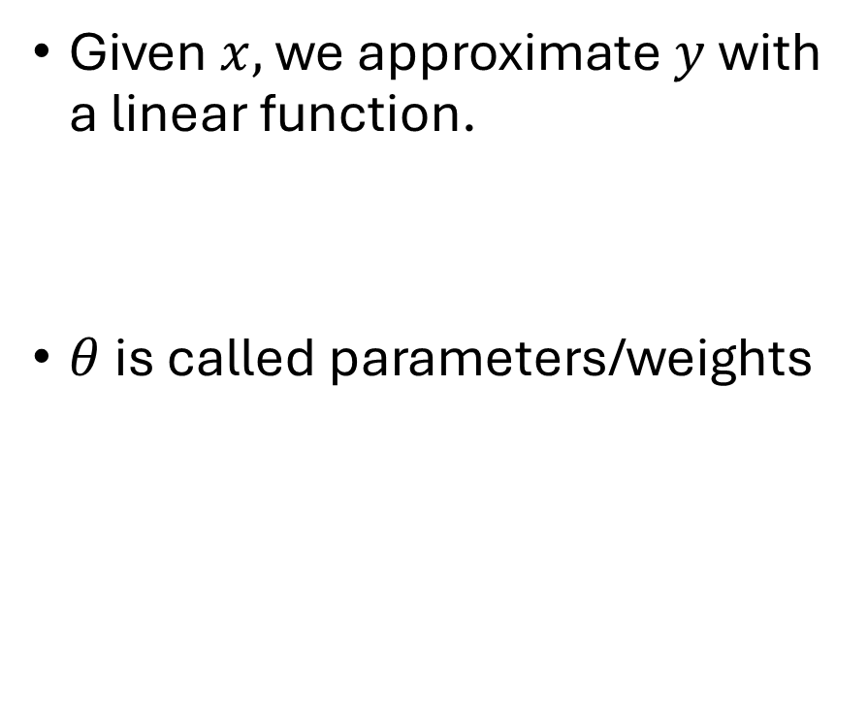
Linear Regression
Given $x,$ we approximate $y$ with a linear function.
$θ$ is called parameters/weights
What about classification?

Slide 3
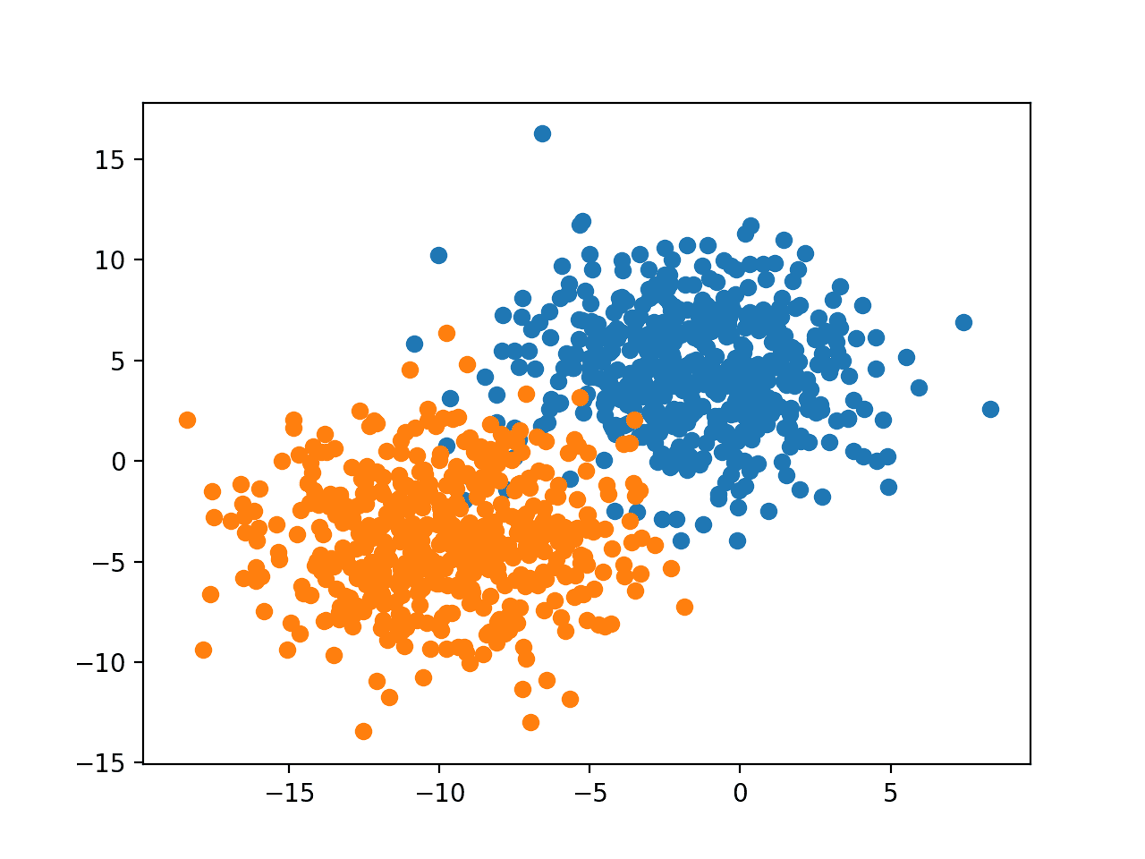
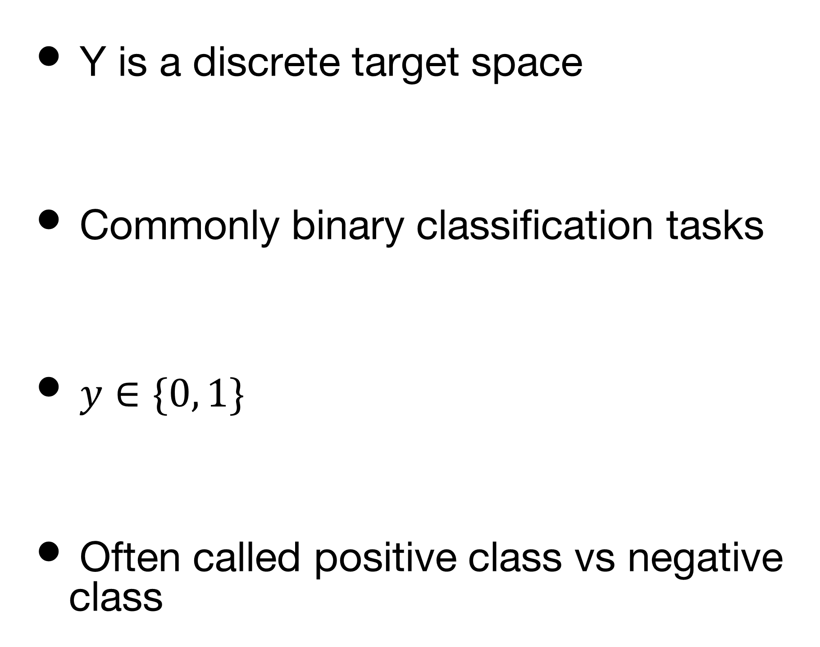
Classification
Y is a discrete target space
Commonly binary classification tasks
$y∈\{0, 1\}$
Often called positive class vs negative class

Slide 4
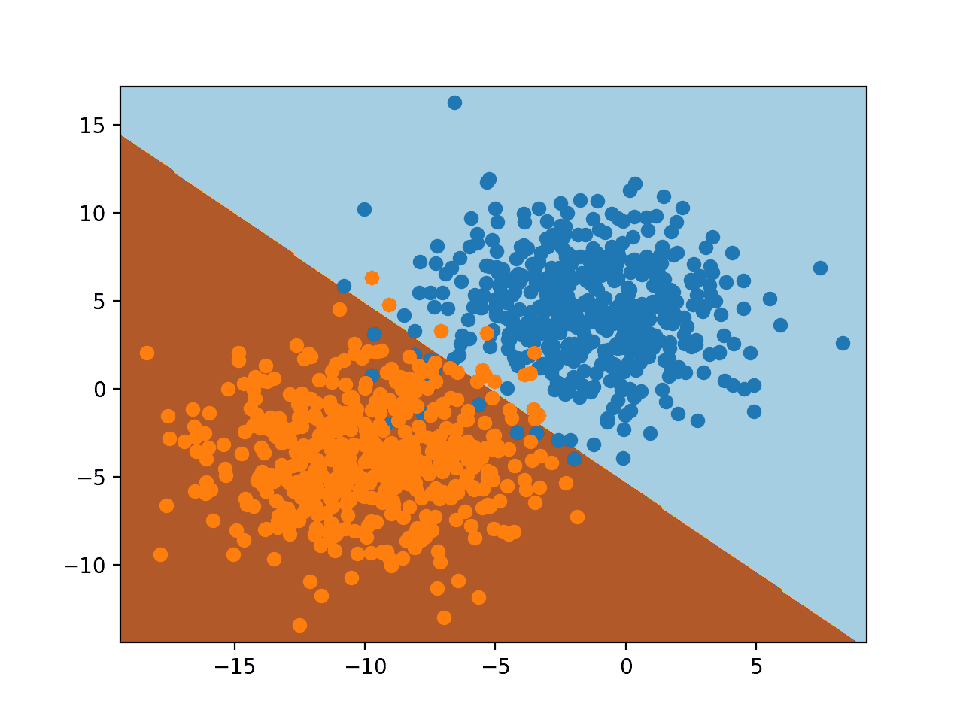
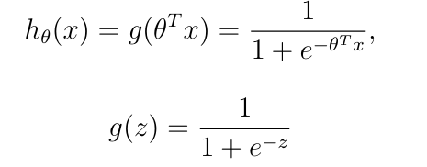
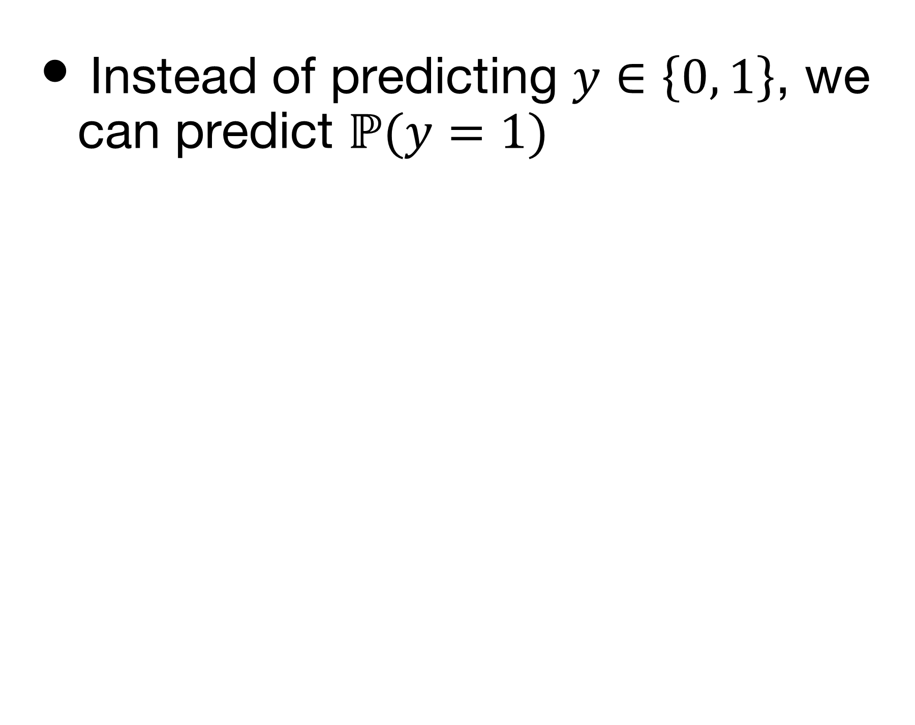
Logistic Regression
Instead of predicting $y∈\left\{0, 1\right\}$, we can predict $ℙ(y=1)$
Why this function?

Slide 5
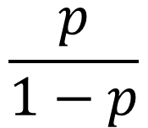
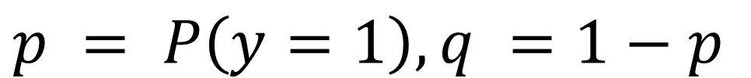
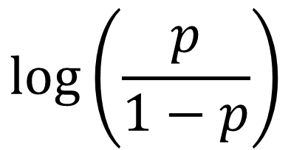
Classification with Linear Classifier
Range
To Predict
Min
Middle
Max
Binary Classification
y
-
Predict
Probability
$$p = P\left(y=1\right), q =1−p$$
Odds
$$\frac{p}{1−p}$$
Log-odds
$$log⁡\left(\frac{p}{1−p}\right)$$
Linear Regression Prediction

Slide 6

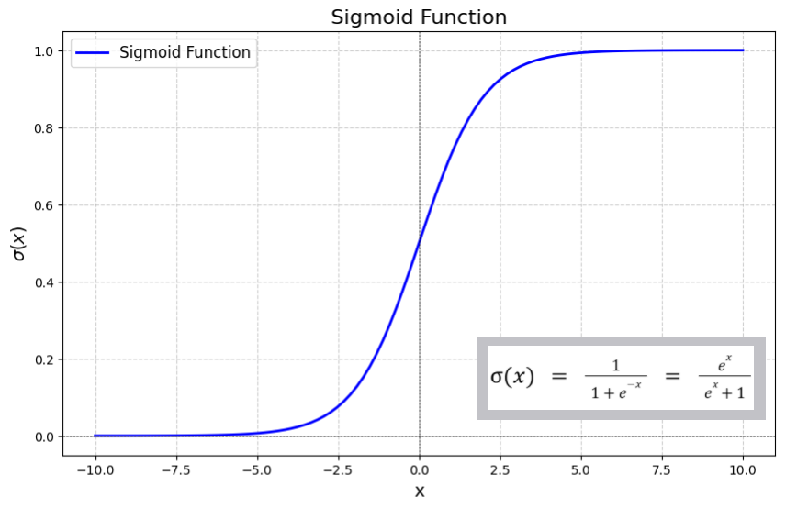
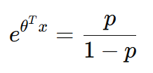


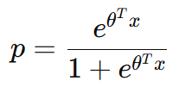


Logistic Regression

Slide 7
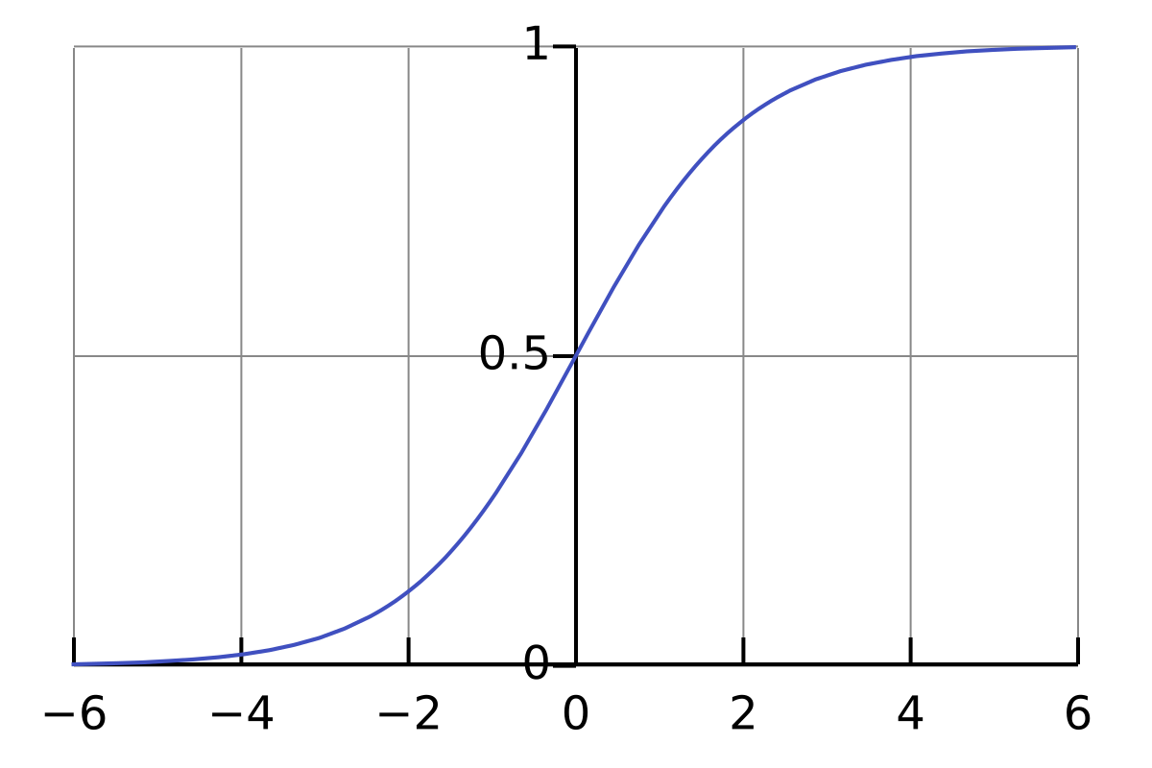
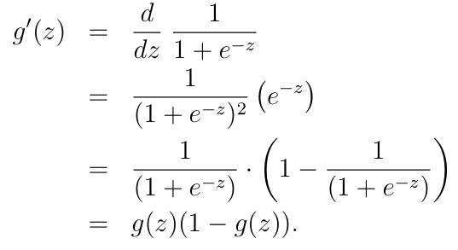
Sigmoid Function
Some properties,

Slide 8

Logistic Regression
How to choose $θ$?
Maximum Likelihood Estimation

Slide 9

Probability (Recap)
Bayes’ Theorem
Given two events A and B,
$$P\left(A, B\right)=P\left(A | B\right)ℙ\left(B\right)=P\left(B | A\right)P\left(A\right)$$
and,
$$P\left(A | B\right)=\frac{P\left(B | A\right)P\left(A\right)}{P\left(B\right)}$$

Slide 10
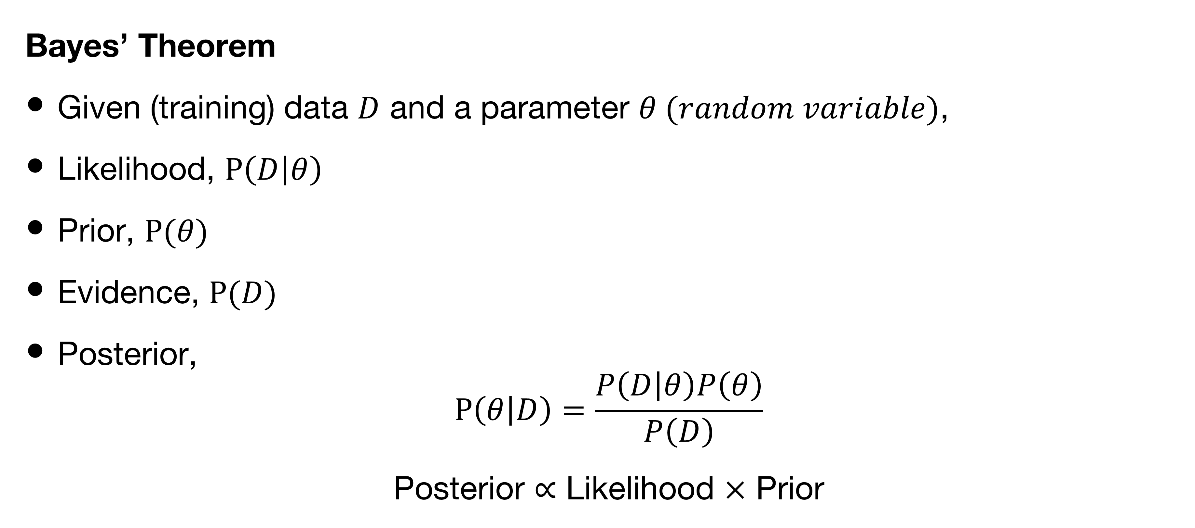
Probability (Recap)
Bayes’ Theorem
Given (training) data $D$ and a parameter $θ (random variable)$,
Likelihood, $P\left(D | θ\right)$
Prior, $P(θ)$
Evidence, $P(D)$
Posterior,
$$P\left(θ | D\right)=\frac{P\left(D | θ\right)P\left(θ\right)}{P\left(D\right)}$$
Posterior $∝$ Likelihood $×$ Prior

Slide 11
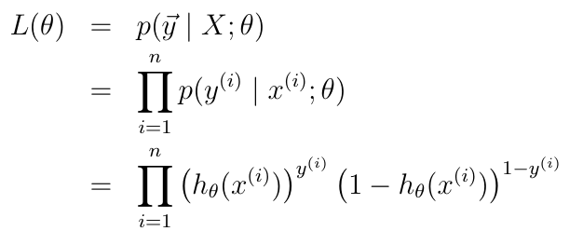
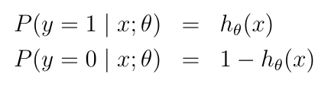

Logistic Regression
We assume
Or,
Likelihood

Slide 12
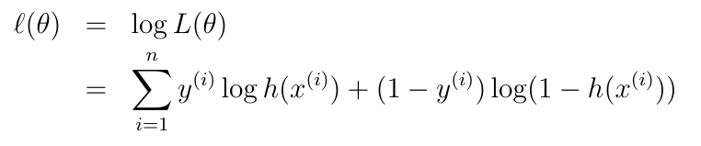
Logistic Regression
Likelihood
Log Likelihood

Slide 13
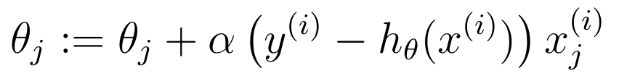
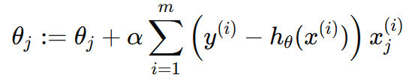
Logistic Regression
Maximize log likelihood with,
Stochastic Gradient Ascent
Gradient Ascent

Slide 14
A short detour …
Parameter Estimation
Maximum Likelihood Estimation
Others??

Slide 15
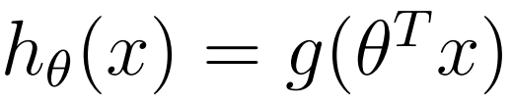
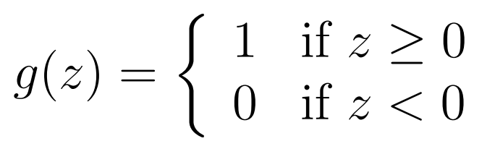
Perceptron
We can modify the logistic regression method to “force” it to output values that are either 0 or 1 or exactly.
Where
With the same update rule,

Slide 16
Reference
CS229 Lecture Note
Section 2.1

